Slide 1
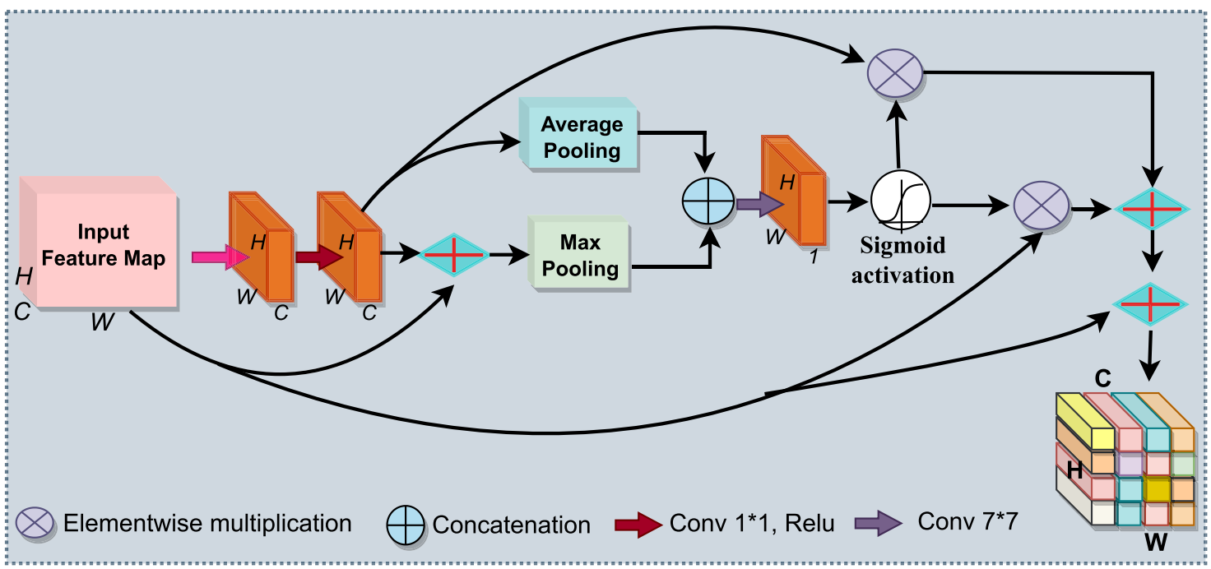
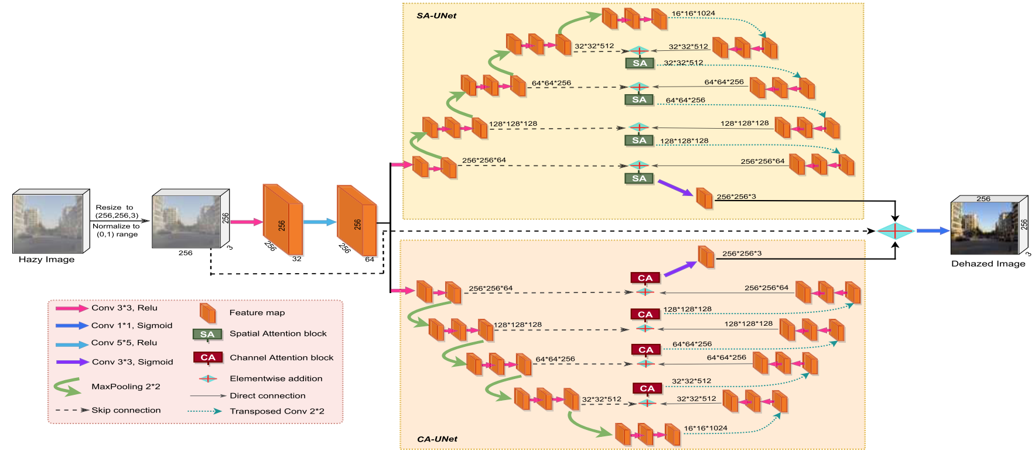
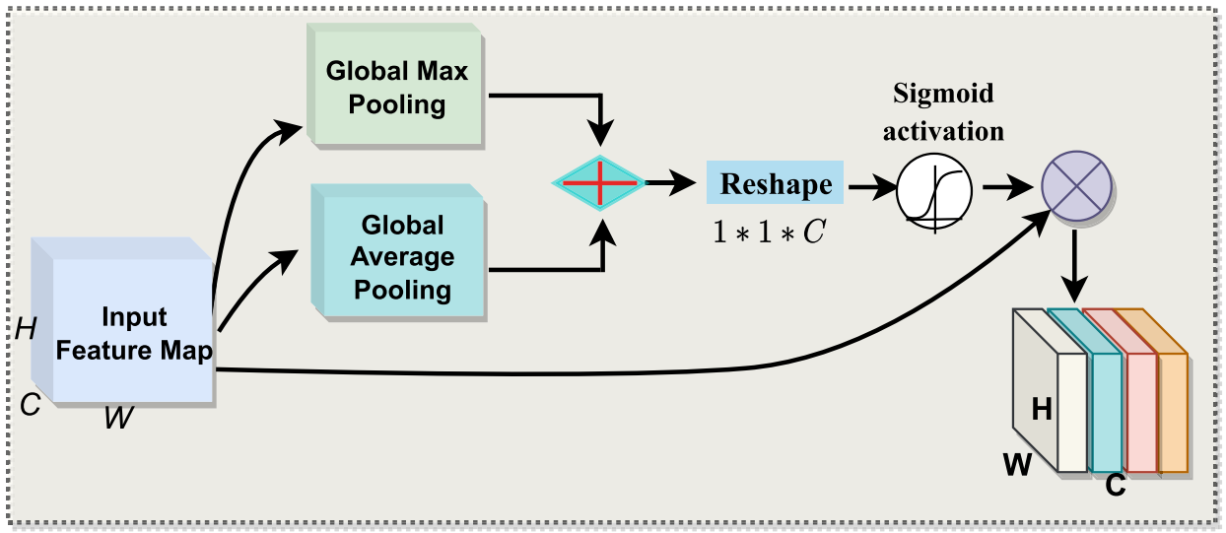
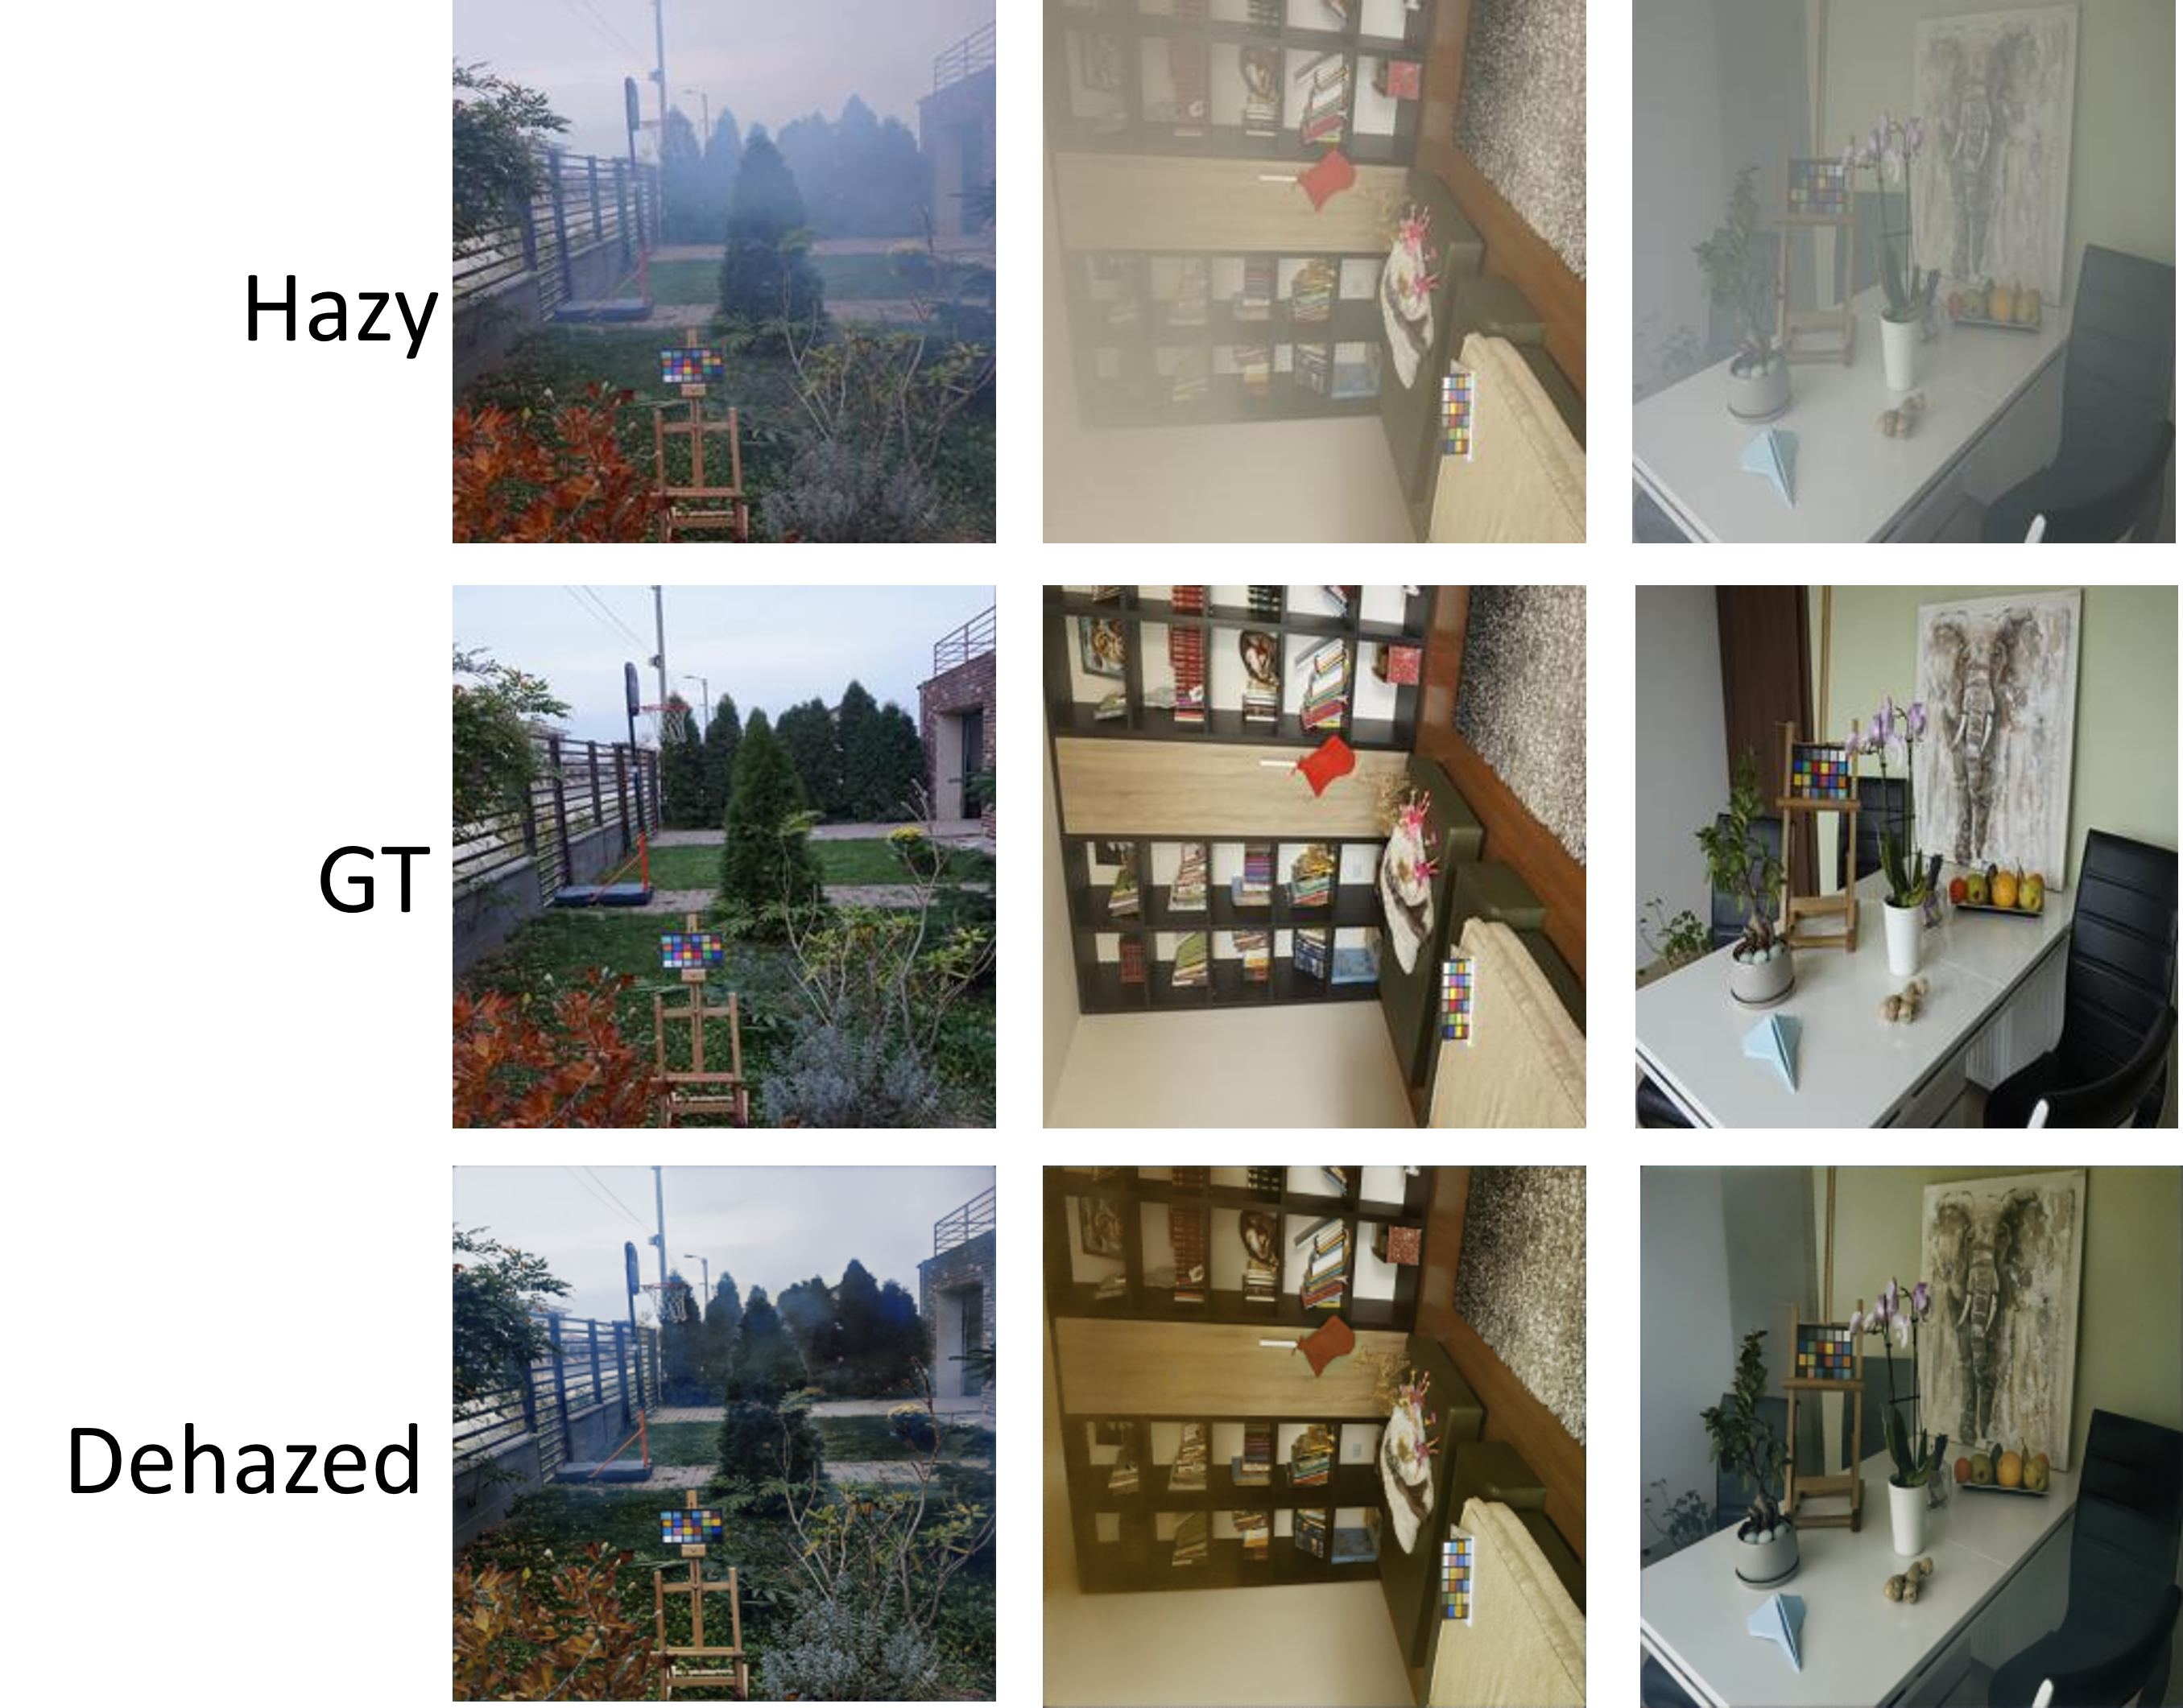
Amity Centre for Artificial Intelligence
Building a smarter world with Artificial Intelligence.
Powered with Most Advanced Supercomputing Facility
Image Visibility Restoration using AI based Computer Vision
Single Image Dehazing via Fusion of Multilevel Attention Network for Vision-Based Measurement Applications
MOTIVATION
DATASET DETAILS
Haze impedes the proper functioning of many outdoor industrial systems, such as autonomous driving, surveillance, satellite imagery, and so on. Conventional visibility restoration methods cannot accurately recover image quality due to inaccurate estimations of haze thickness and the presence of color-cast effects. Deep neural networks are evolving due to their ability to directly dehaze images from hazy scenes.
Ten datasets are utilized for experimentation. Out of ten datasets, seven datasets, namely, foggy road image database, HazeRD, NYU-Depth, Dense-Haze, OTS, NH-Haze, and synthetic objective testing set, consist of synthetic hazy images, while the remaining three - E-TUVD, RailSem19, and some Internet images, contain natural hazy images.
Fig. 2: Spatial Attention Module
PROPOSED APPROACH
The proposed framework consists of four parts, namely, a base feature extraction module to extract the low-level image features, two multiscale attention UNets to learn haze features, and a multi-feature fusion to reconstruct the latent haze-free image. The base features acquired from two convolutional layers are then processed by multiscale attention Unets. The first module is responsible for constructing a structural attention matrix that describes the spatial relationship between image pixels. The second module focuses on channels, emphasizing more crucial ones. Finally, we performed an elementwise sum between the features of the two modules and the original image to better capture the characteristics of the hazy image and get a smooth dehazed image.
Fig. 1: The block diagram of the proposed methodology for single image dehazing
Fig. 3: Channel Attention Module
CONCLUSION
This study introduced an end-to-end single-image dehazing model designed for vision-based measurement systems. The model is trained on the combined dataset formed from six vivid image dehazing datasets. This approach helps the model learn various features of a hazy image. The model uses the concepts of multiscale feature extraction, multilevel attention, and skip connection. All these concepts help the model restore more details and reduce artifacts in dehazed images.
EXPERIMENTAL RESULTS
Both qualitative and quantitative results are observed to finalize the model parameters and it is observed that the proposed model is giving better results with Adam optimizer, learning rate of 0.0001, number of epochs as 50, a batch size of 16 and SSIM as a loss function. The proposed model is tested on the test set images which were not used while training.
Fig. 4: Qualitative results of the proposed approach on the test set of images
Name:
Enrollment No.:
Department:
Institute:
Email ID:

